Slide 1

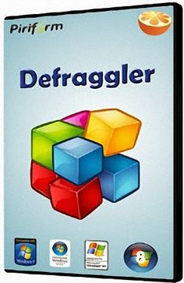
Group: L1 C1
Defraggler
Agendas
Welcome to our learning object about Defraggler. In this learning object we are going to teach about how to use Defraggler and its function.
Introduction
Installation
Features
Quiz
Appendix
References

Slide 2

Agendas
Home
Introduction
Installation
Features
Quiz
Appendix
References

Slide 3
Introduction
Home
What is can it do?
What is Defraggler?
Defraggler is a small but powerful utility made for Windows. It is a software developed by Piriform. It lets you defrag hard drives on the system. It defrags the hard dives by defragmentation method. Defragmentation is a process of locating and re arranging the fragmented files. Defraggler speeds up the computer by placing all the parts of a file on the same section of the hard drive.
Defraggler can:
Clean up your hard drive by defragging it
Defrag an entire drive, a folder, or one or more individual files
Defragment the freespace on your drive by gathering all the free areas into a single large freespace
Speed up your PC by placing pieces of files together
Run from a USB drive
Defragment drives sequentially (ctrl click the drives and press Defrag)
Defragment RAID drives
Defraggler can't:
Defraggler can't defragment multiple drives at once.
at once.
Defraggler does not currently support Mac OS X or Linux

Slide 4
Installation
Home
System Requirements:
Defraggler will run on any PC running Microsoft Windows XP or later.
Installation process:
You can easily download Defraggler from piriform.
Windows 8 (all editions, including 64-bit)
Windows 7 (all editions, including 64-bit)
Windows Vista (all editions, including 64-bit)
Windows XP (Home, Professional, Media Center, Tablet Edition, 64-bit)
Windows 2003 and 2008 Server (all editions)
Defraggler is a small, efficient program, so there are no minimum memory or hard drive requirements.
Go to the the website of piriform or click the below link.
http://www.piriform.com/defraggler
Free download the latest version of Defraggler.
You could also download professional Defraggler by paying.
Install it in your pc or laptop.
Defraggler does not currently support Mac OS X or Linux.

Slide 5


Features
Safe and secure
Compact and portable
Defragment free space
Quick defrag
Defragment exactly what you want
Analyzing a drive
Defragrmenting a drive
To Search for a file
Defragmenting files and folders
Home
Basics
Advanced
Scheduling
Defraggler
Tutorial

Slide 6
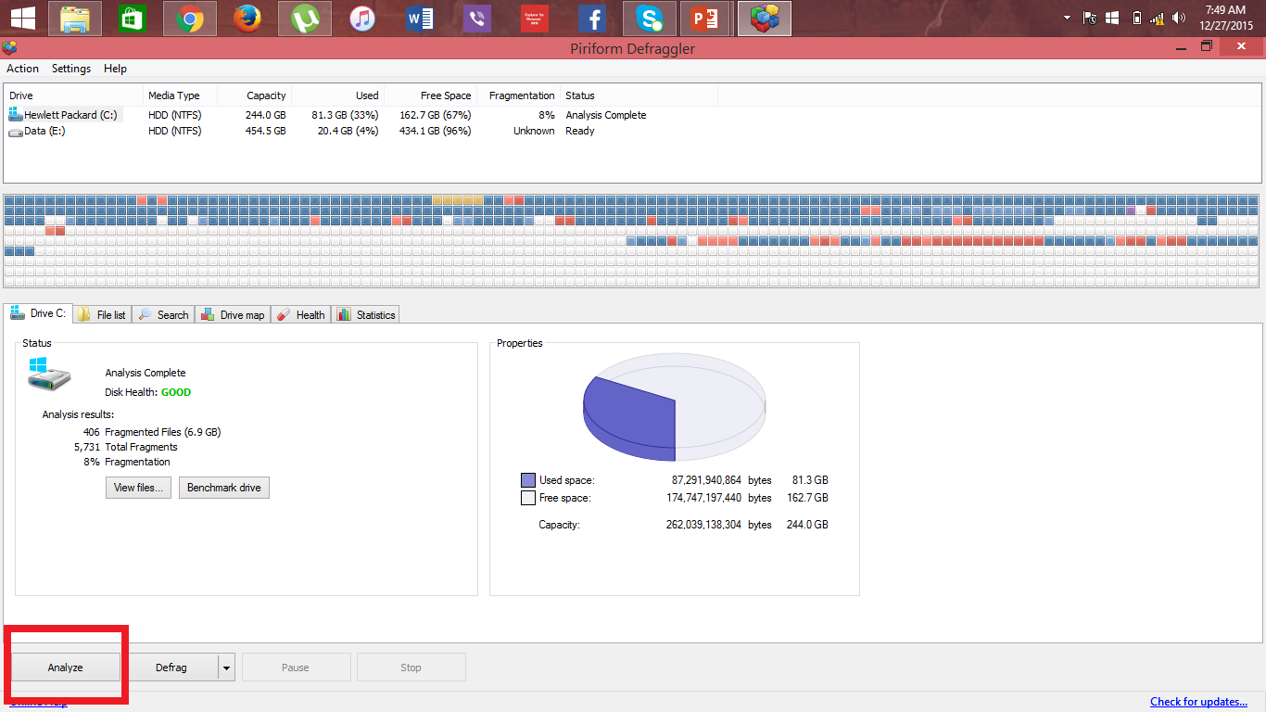
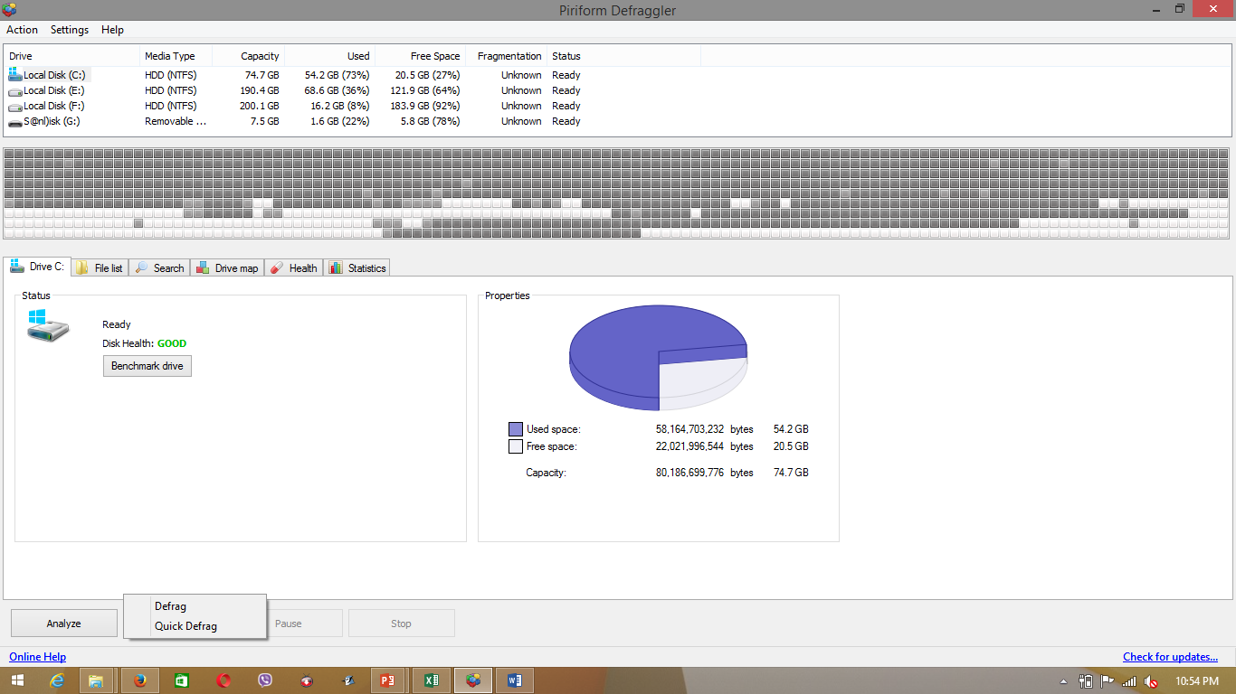
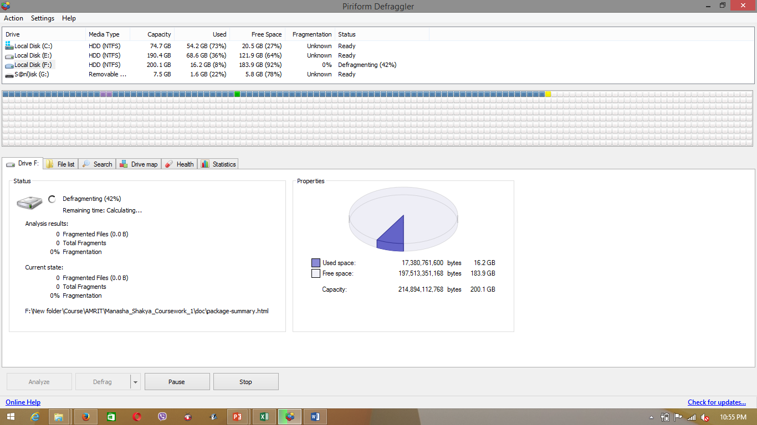
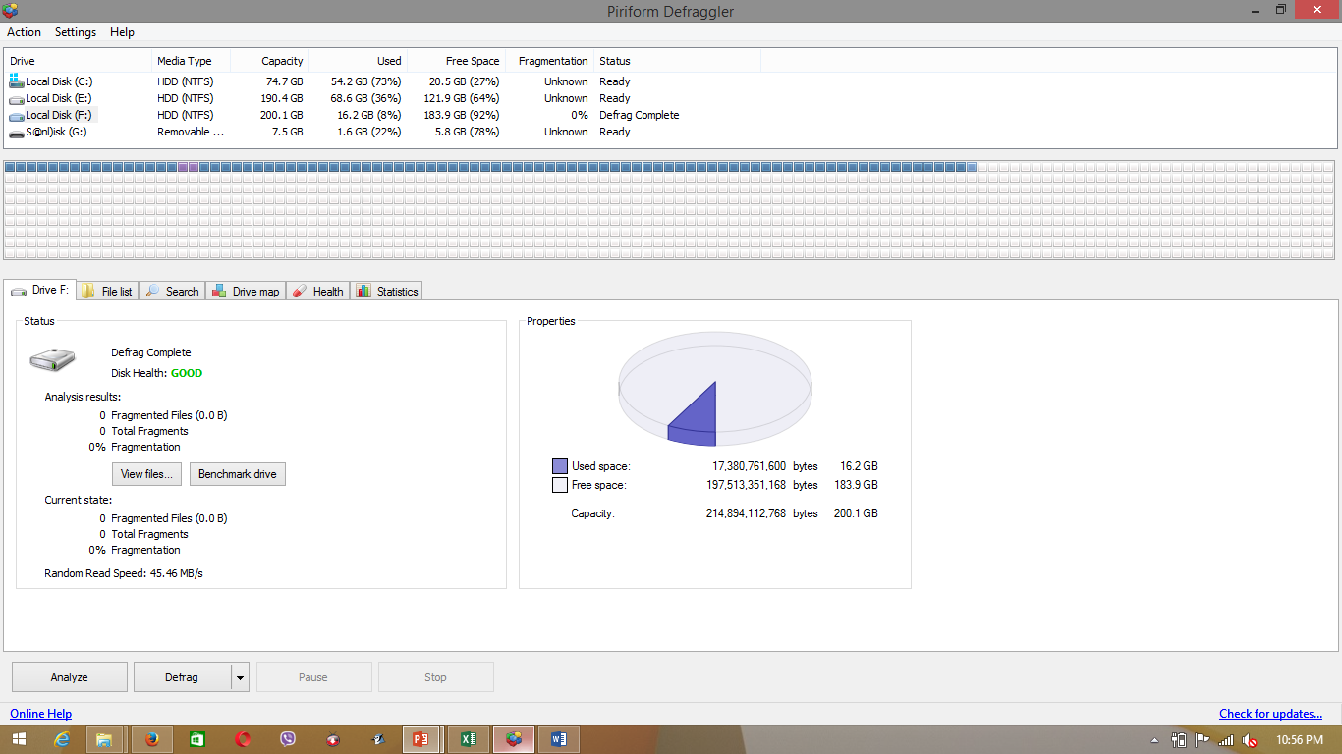
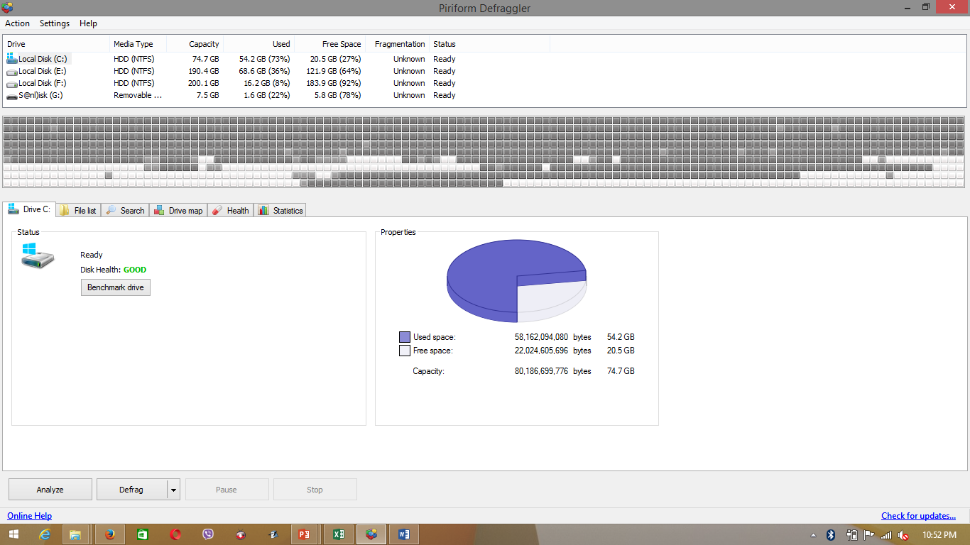
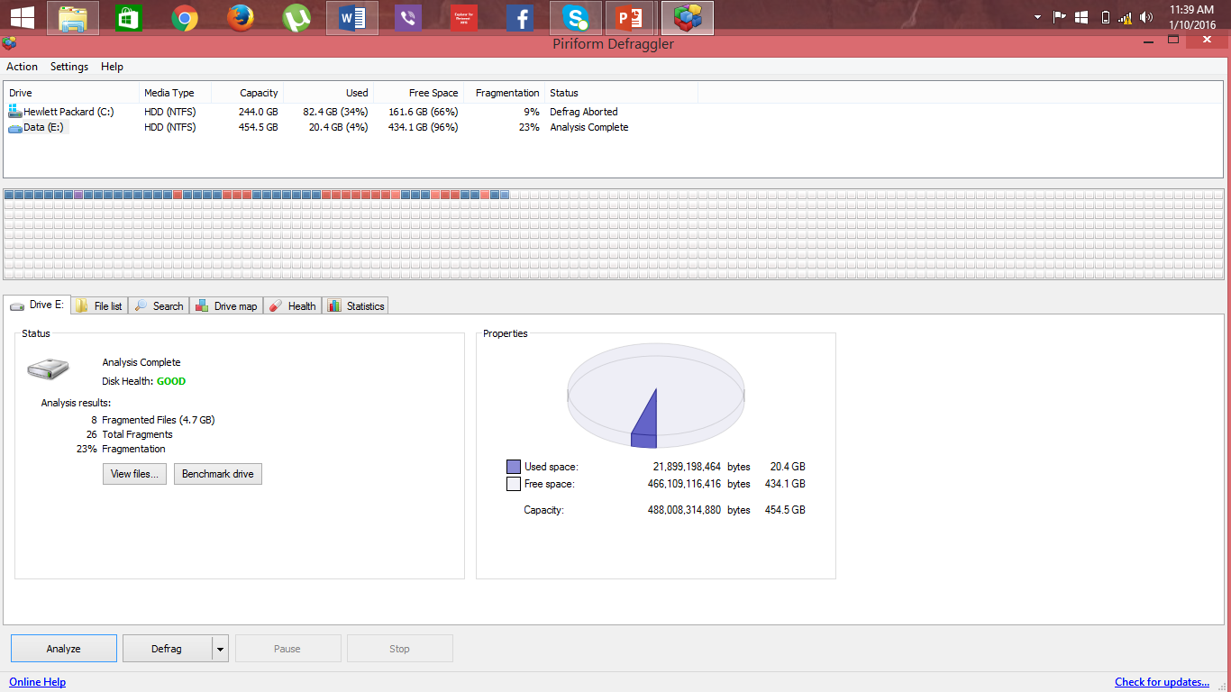
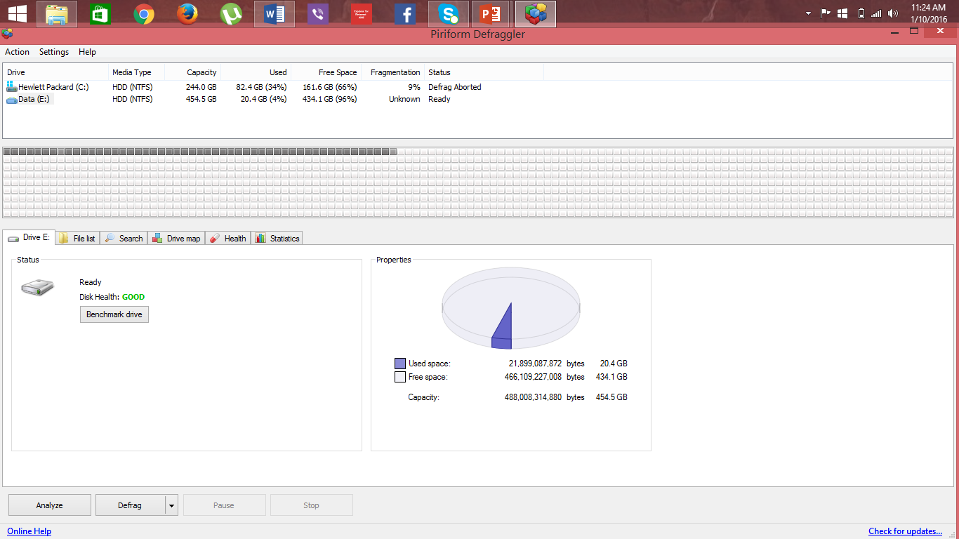
Analyzing and defragmenting
a drive
Select here
Select either drive
Step 1
select the drive you want to analyze at the top of the window.
Home
Step 2
Click the Analyze button.
Step 4
Once defragmentation is complete, Defraggler will display a list of results.
To see the results of other drives just change the disk.
Click here
Features
Click here
Step 3
Defraggler defragments the selected drive. You can pause or stop the process at any time using the Pause and Stop buttons.
Click here
Tutorial
Advanced
Step 2
Click the Defrag button. Or, to run a quick defrag, click the down-arrow on the Defrag button, and then click Quick Defrag
Step 1
In Defraggler, select the drive you want to defragment at the top of the window.
Defraggler displays the results in graphical format and as text.
Click here
Select here

Slide 7
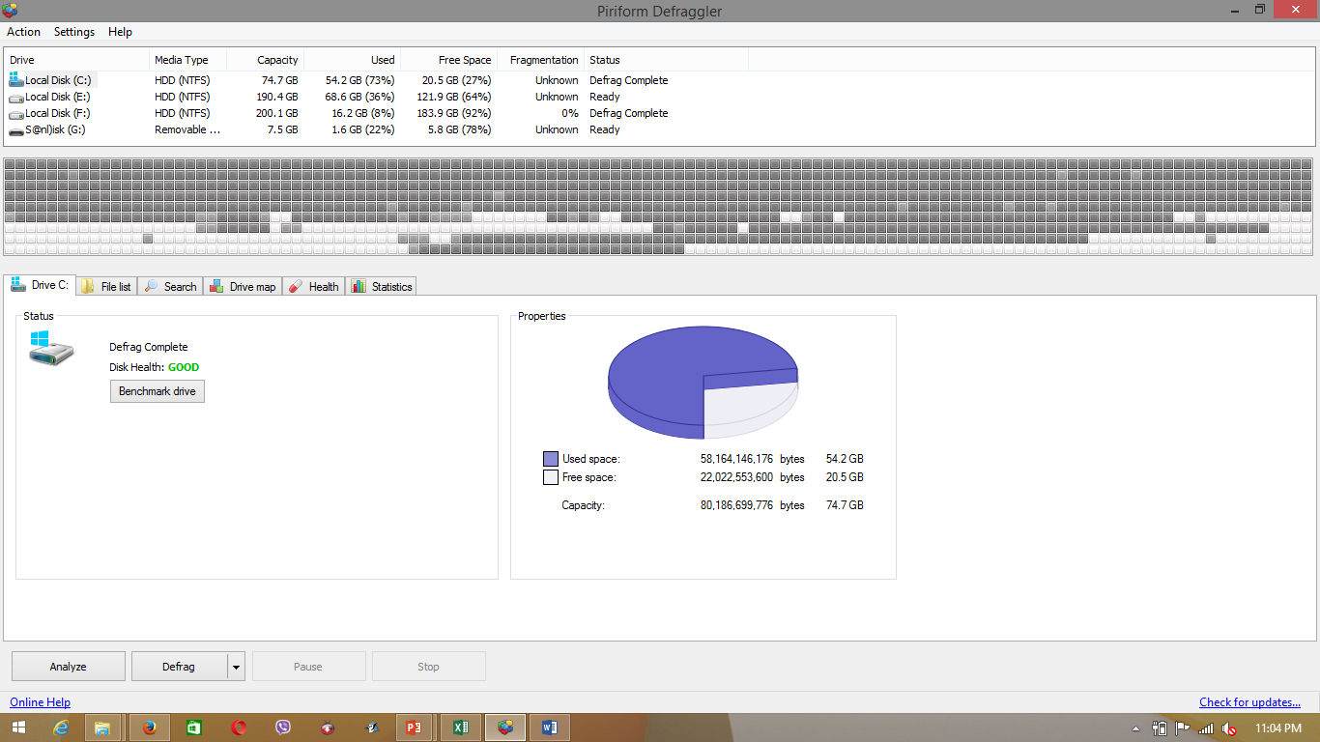
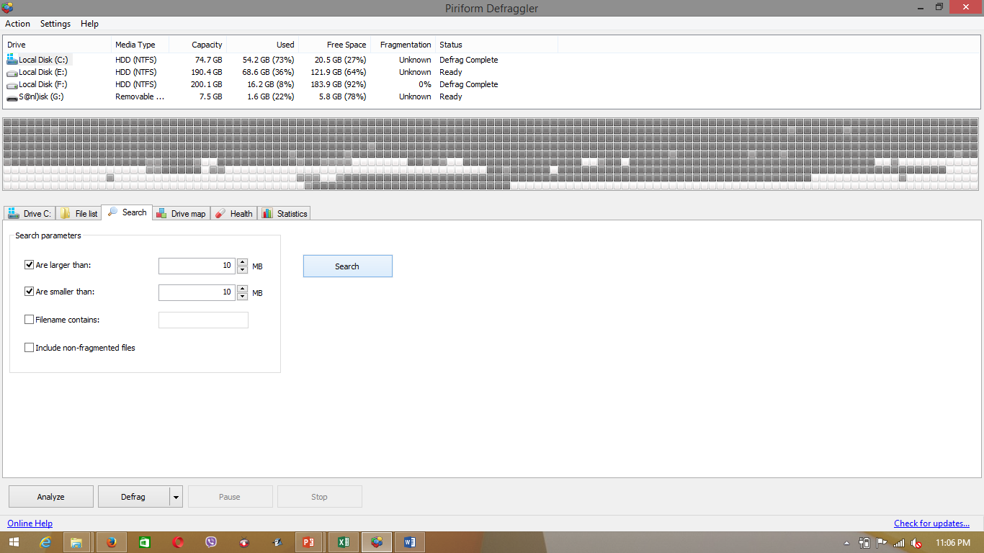
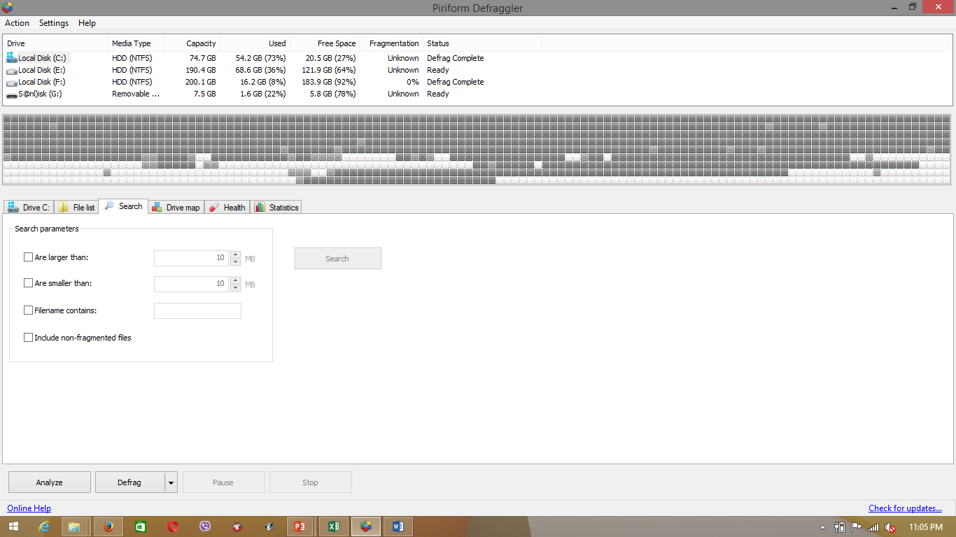
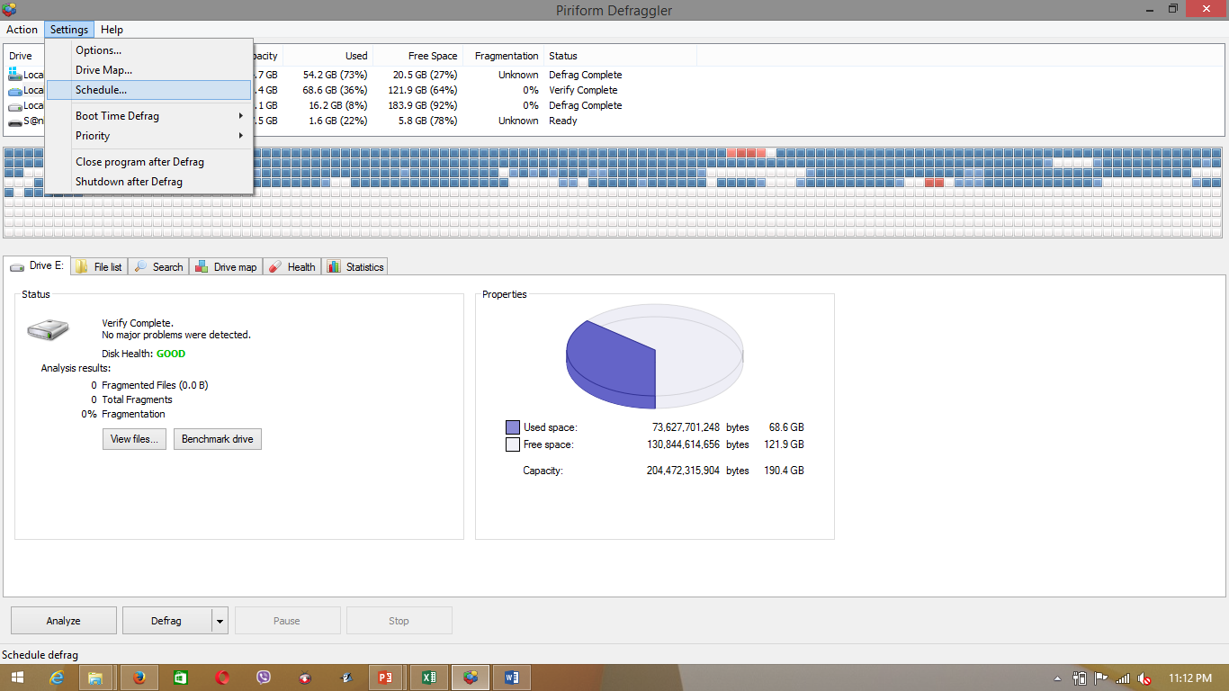
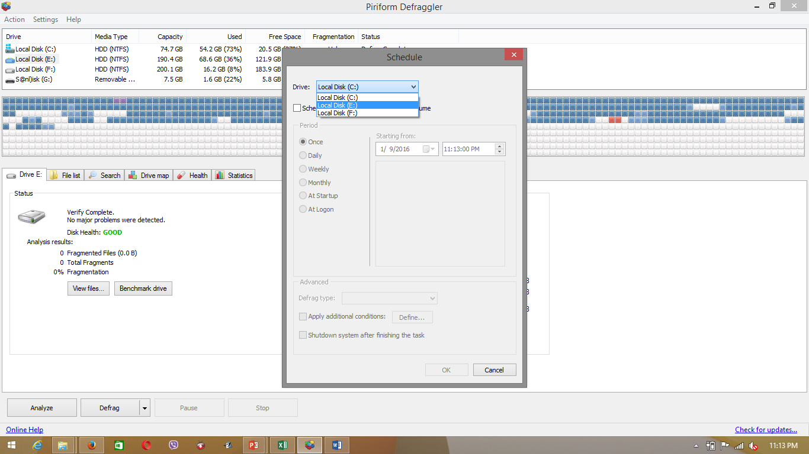
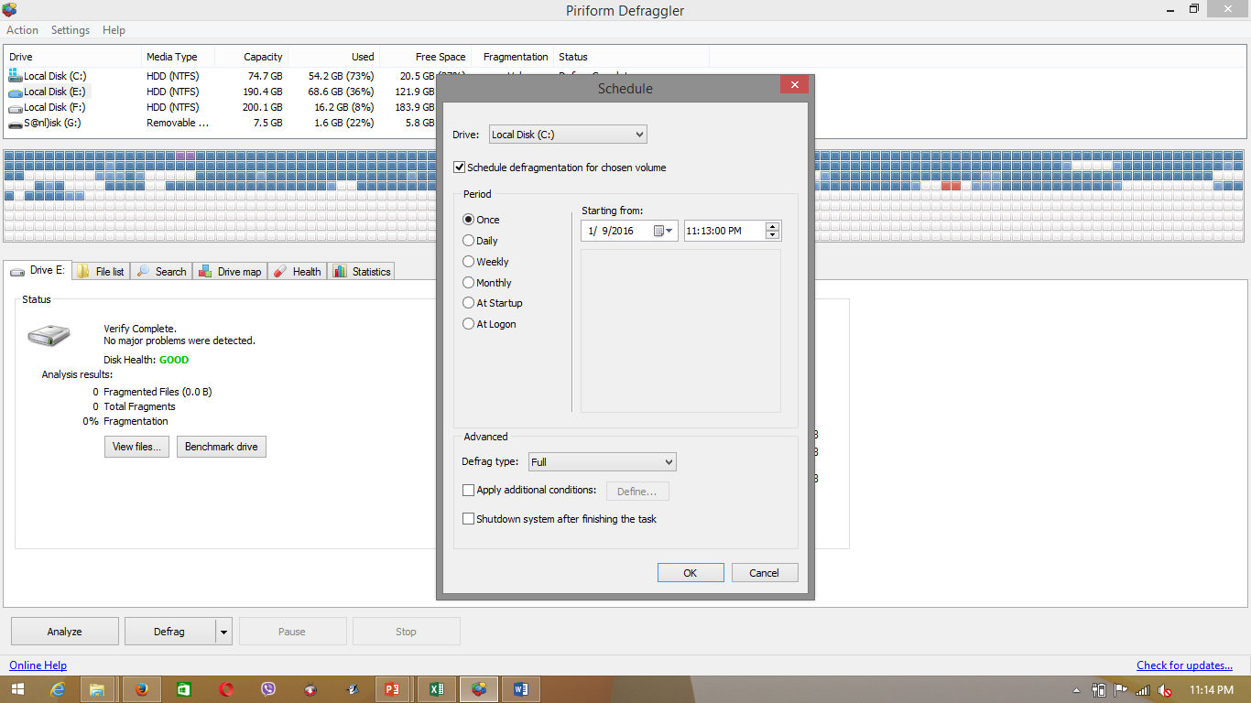
To Search for a file
Scheduling Defraggler
Select here
If you want to add a scheduled entry for another drive
selecting the new drive from the Drive drop-down box.
Step 1
Select the drive you want to search in the top window.
Step 1
Select Settings, and then click the Schedule option.
Step 2
Select the drive you want to schedule Defraggler to defragment
Step 3
Check Schedule defragmentation for chosen volume and then Click OK.
Home
Features
Choose how often you want Defraggler to run
Tutorial
Select the date and time when you want Defraggler to start.
Step 3
Select one or more search options, and then click Search.
Click here
Advanced
Step 2
Click the Search tab.

Slide 8
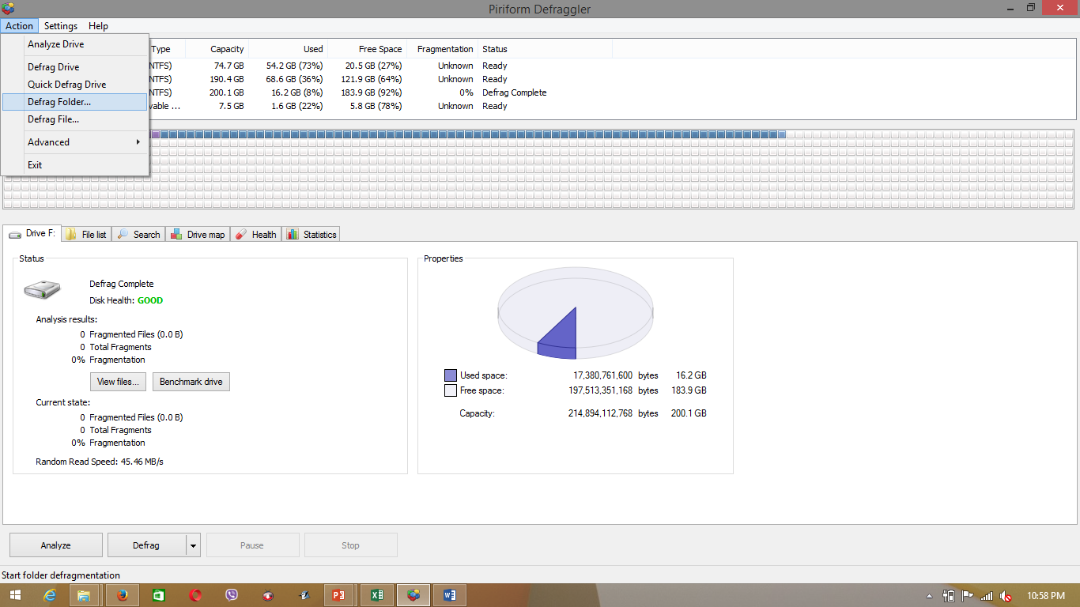
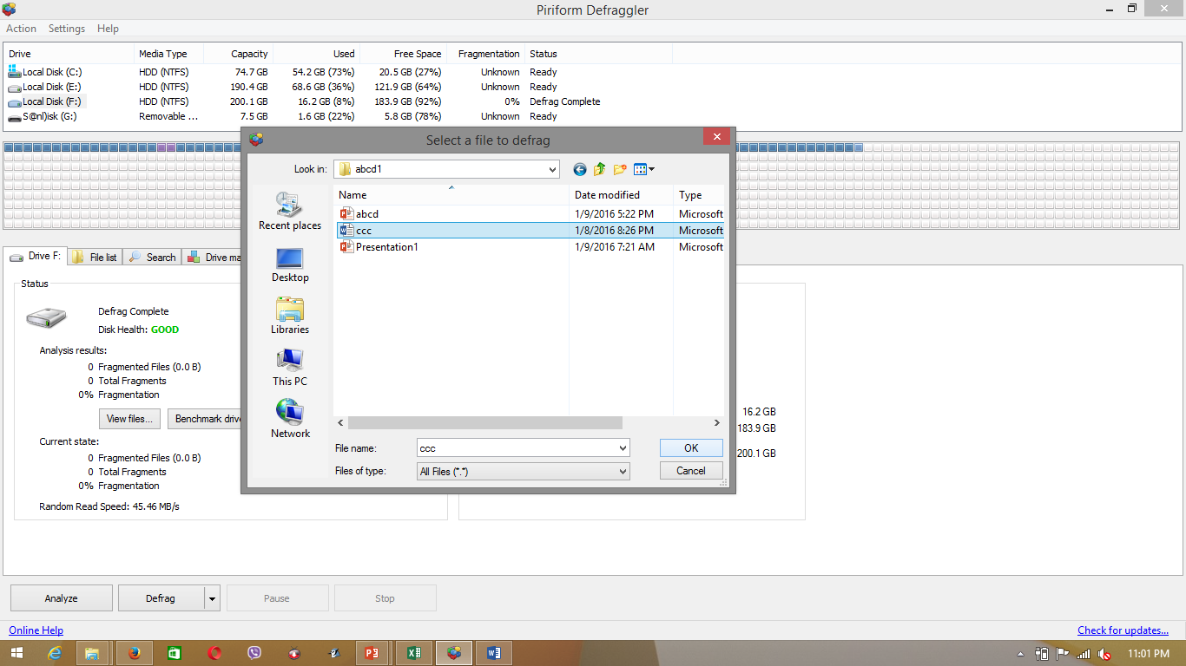
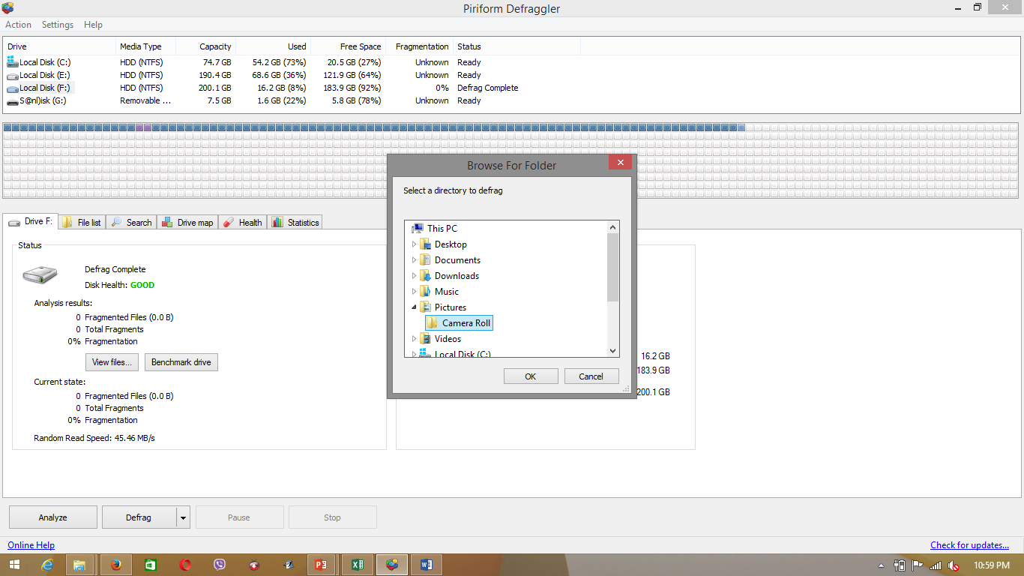
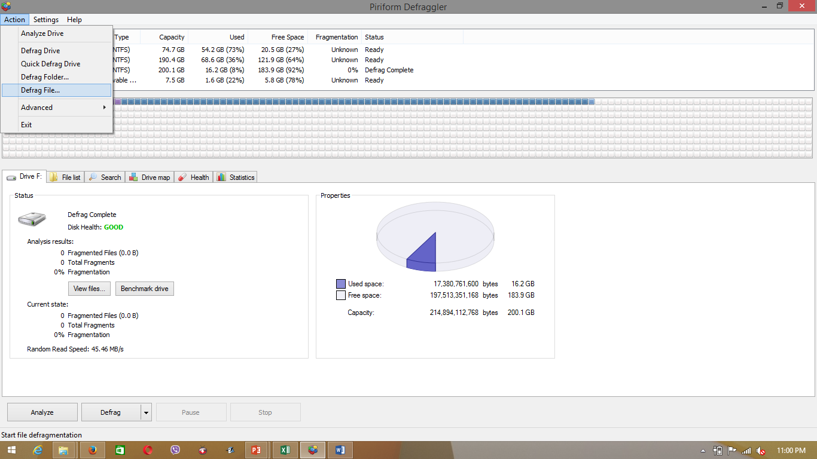
Defragmenting folders and files
Home
Step 2
In the Browse for Folder dialog box, browse to and select the folder to defragment and then click OK.
Click here
Step 1
Select Action, and then select Defrag File...
Step 1
Select Action, and then select Defrag Folder
Features
Tutorial
Advanced
Step 2
In the Select a file to defrag dialog box, browse to and select the file to defragment and then click OK.

Slide 9
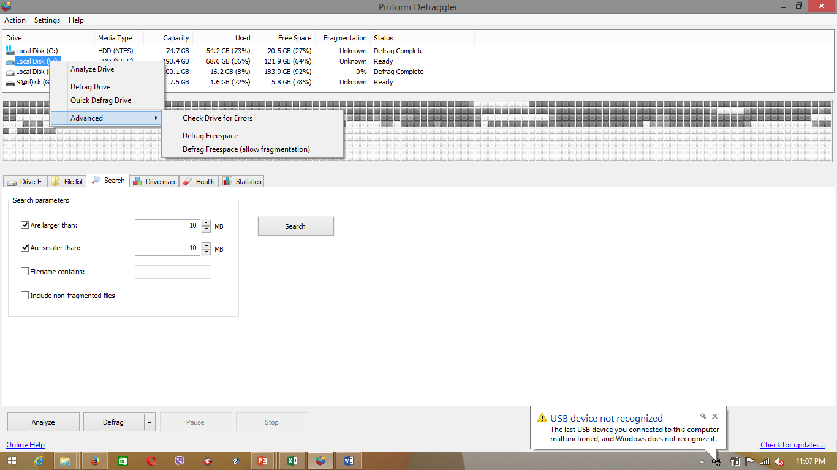
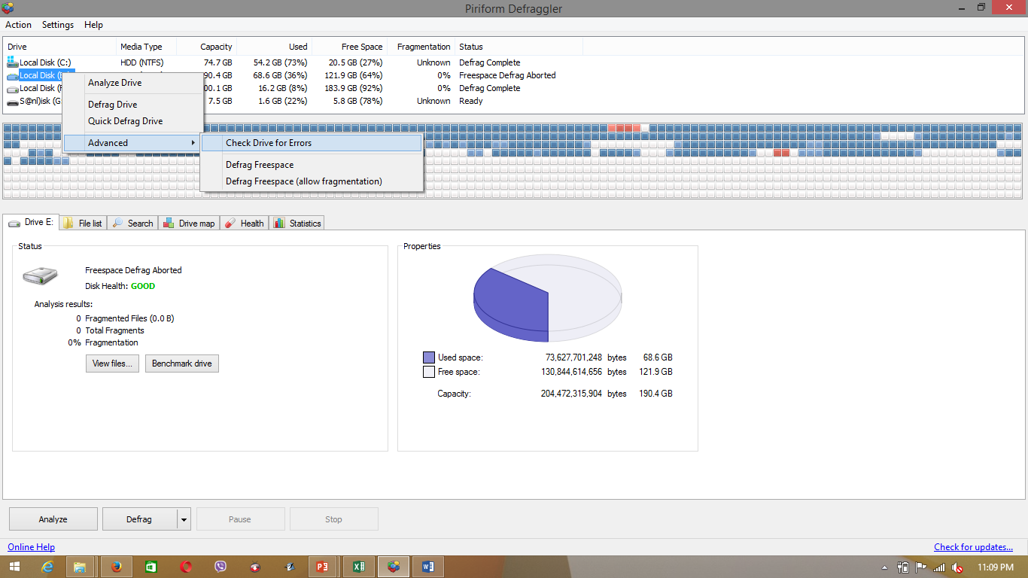
Defragmenting free space
Checking Drive for errors
Home
Features
Step 1
In the Drive section at the top of the Defraggler window, right-click the drive to defragment, and then click Advanced.
Tutorial
Step 1
In the Drive section at the top of the Defraggler window, right-click the drive to defragment, and then click Advanced.
Advanced
Step 2
Click Defrag Freespace or Defrag Freespace (Allow fragmentation).
Step 2
Click Check Drive For Errors

Slide 10
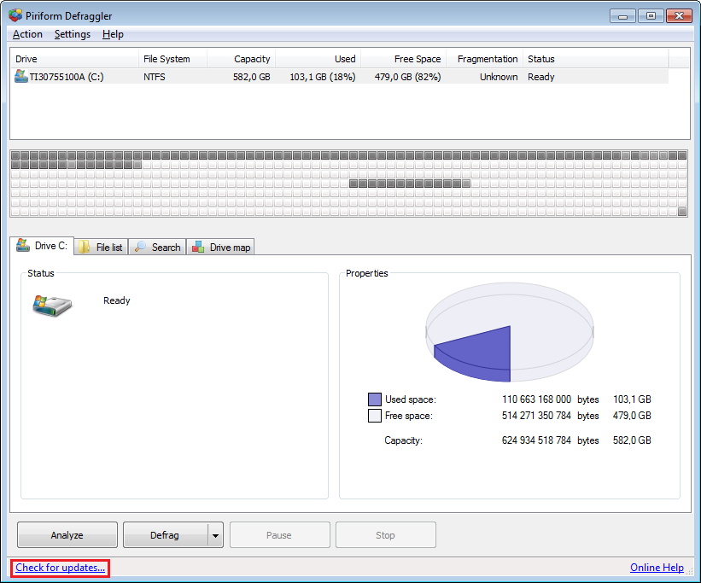
To Run from USB drive
Check For Updates
Home
Download the latest version of Defraggler in ZIP format.
Unzip the ZIP file into a folder.
Copy the contents of the ZIP file to a USB stick.
Create a dummy portable.dat file in the folder. You can do this by right-clicking a blank area in the folder, and then clicking New, and then Text Document. Replace the New Text Document.txt file name with portable.dat and then press Enter. You will be prompted to confirm the file extension change. Click Yes.
To run Defraggler from the USB drive, double-click the Defraggler.exe file in the Defraggler folder.
To check for updates, click the Check for updates... link at the lower left-hand corner of the Defraggler window. Your Internet browser will open and the Defraggler site will tell you if you have the latest version, or will give you a link to the latest update.
Features
Tutorial
Advanced

Slide 11
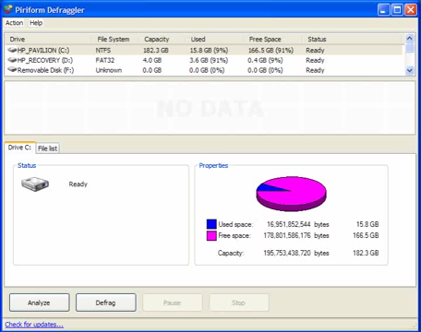
Tutorial
Home

Slide 12


Quiz
Home
Who invented Defraggler?
Apple.Inc
Piriform
Samsung
2. Does Defraggler work in Macintosh Operating System?
Yes
No
3. Can Defraggler defrag a whole drive?
Yes
No
4. Can Defraggler defrag freespace in a disk?
Yes
No
Next Question
Next Question
Next Question
5. Defraggler does not have the features for showing
the health of a particular chosen drive?
Next Question
True
False

Slide 13
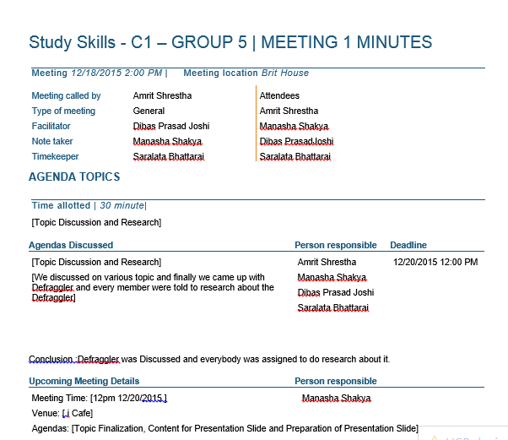
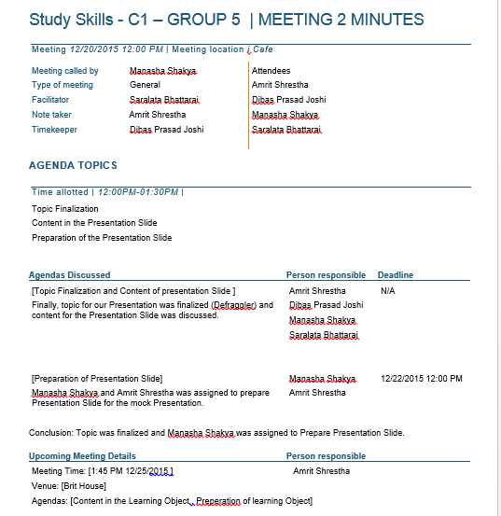
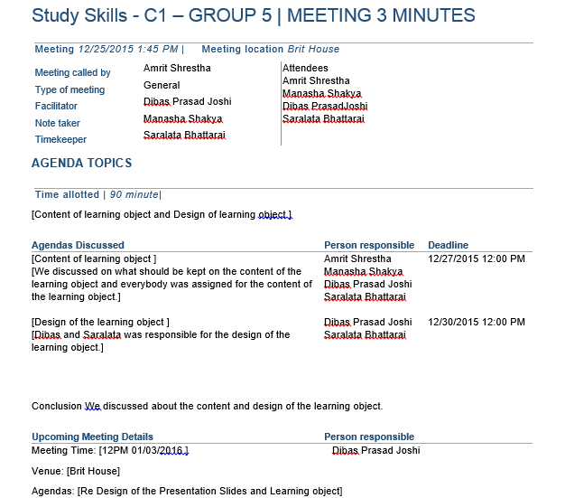
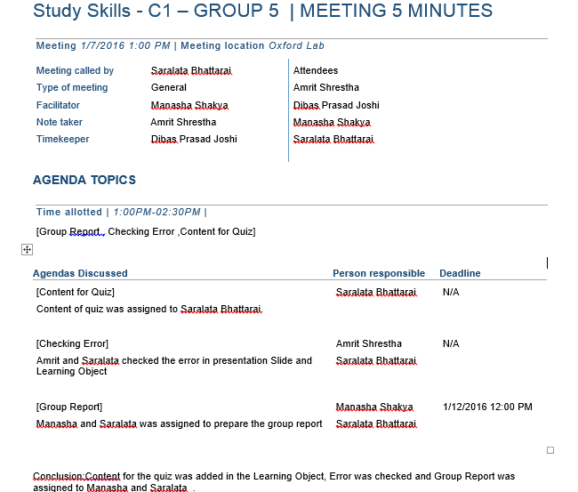
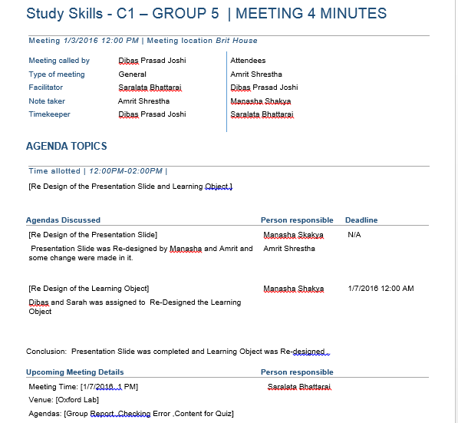
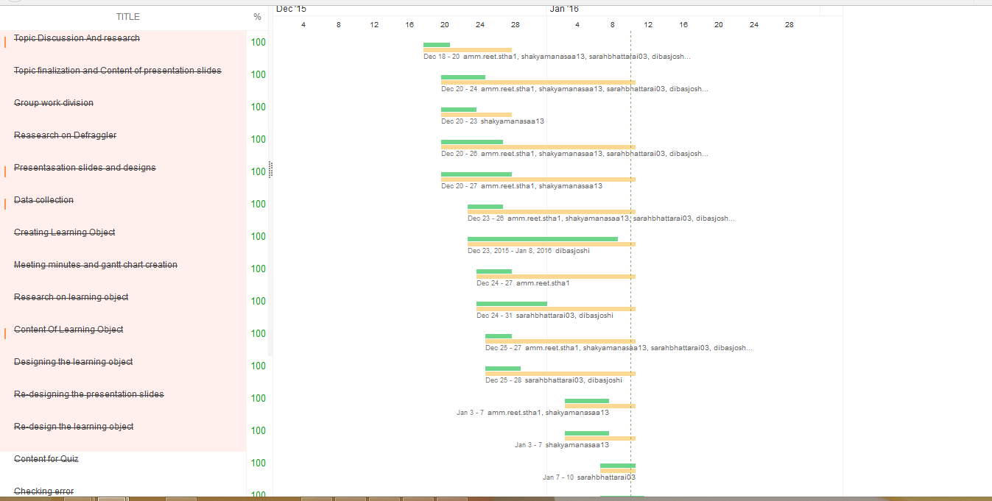
Appendix
Home
Gantt Chart and Meeting Minutes

Slide 14
References
Home
Hacker, L. (n.d.) Most Popular Disk Defragmentation Tool [Online]. Available from: http://lifehacker.com/5855152/most-popular-disk-defragmentation-tool-defraggler [Accessed 27 December 2015].
Hippo, F. (n.d.) Computer Slow And Unresponsive? Try Defraggler. [Online]. Available from: http://news.filehippo.com/2015/03/computer-slow-unresponsive-try-defraggler [Accessed 27 December 2015].
Piriform. (n.d.) Defraggler [Online]. Available from: http://www.piriform.com/defraggler [Accessed 27 December 2015].

Slide 15
References
Home
Softonic. (n.d.) Users reviews for Defraggler [Online]. Available from: http://defraggler.en.softonic.com/comments [Accessed 27 December 2015].
Target, T. (n.d.) Defragmentation [Online]. Available from: http://searchwindowsserver.techtarget.com/definition/defragmentation [Accessed 27 December 2015].
Wikipedia. (n.d.) Defraggler [Online]. Available from: https://en.wikipedia.org/wiki/Defraggler [Accessed 27 December 2015].

